Slide 1
Use of Statistics in Cognitive Linguistics
Laura A. Janda
laura.janda@uit.no

Slide 2
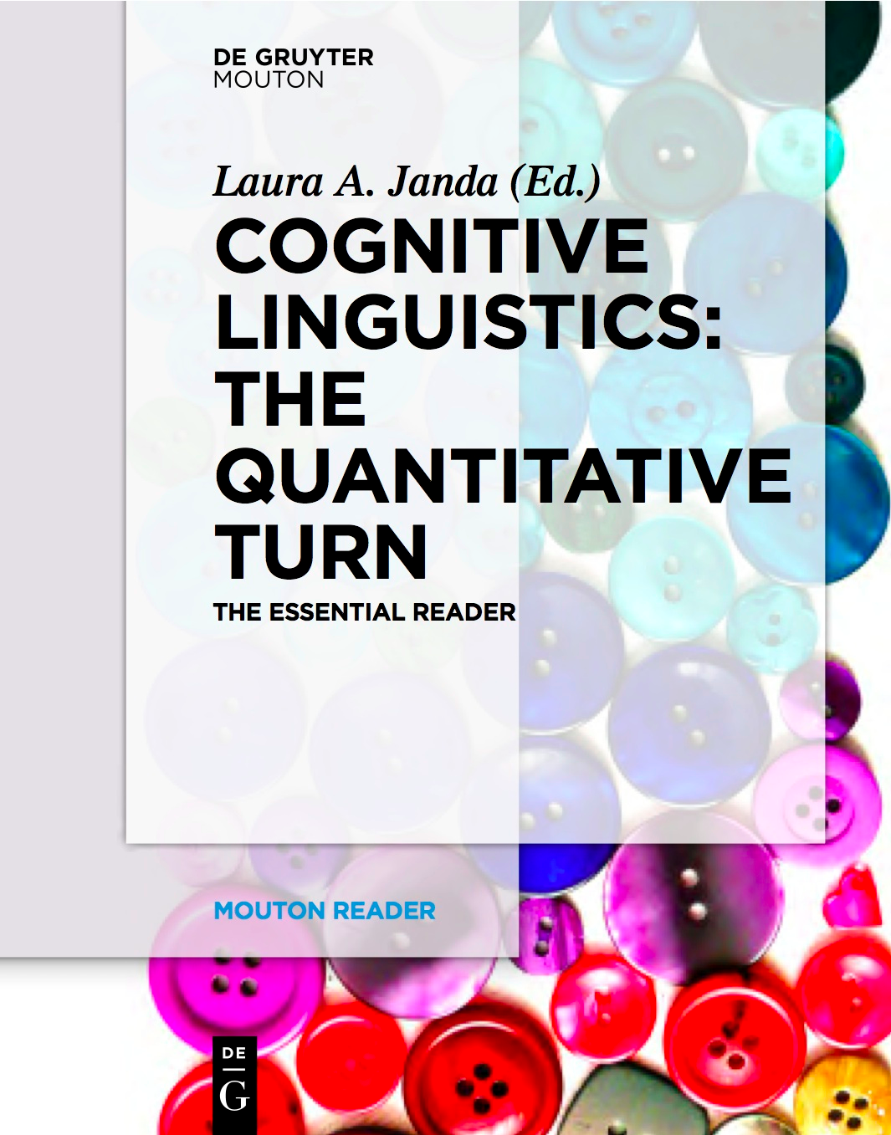
This presentation has two parts
Part 1 is an overview of how statistical models have been used in cognitive linguistics
Part 2 shows some examples of statistical analysis from my own work

Slide 3

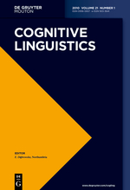
A survey of use of statistics in articles in Cognitive Linguistics, 1990-2012
Concrete examples of how researchers have applied statistical models in linguistics

Slide 4
?

Slide 5
The Quantitative Turn: 2008
Facilitated by theoretical and historical factors
CL is usage-based, data-friendly – quantitative studies have always been part of CL
Advent of digital corpora and statistical software
Progress in computational linguistics
What this means for the future
All linguists will need at least passive statistical literacy
We need to develop best practices for use of statistics in linguistics
Public archiving of data and code will contribute to advancement of the field

Slide 6
Statistical Methods and How We are Using Them
These are the methods most common in Cognitive Linguistics:
Chi-square
Fisher Test
Exact Binomial Test
T-test and ANOVA
Correlation
Regression
Mixed Effects
Cluster Analysis
I will give some examples of how these methods have been applied in Cognitive Linguistics and I will also show how I personally have applied statistics in linguistic profiling analyses

Slide 7
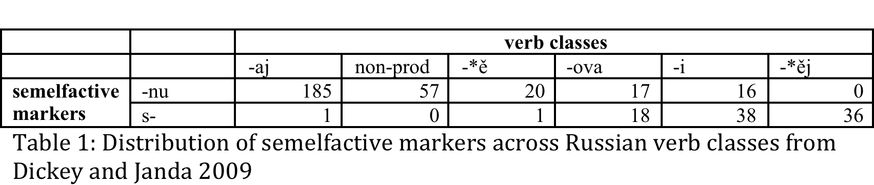
Chi-square: Finding out whether there is a significant difference between distributions
Illustration: Is there a relationship between semelfactive markers and verb classes in Russian?
Result: chi-squared = 269.2249, df = 5, p-value < 2.2e-16
Cramer’s V = 0.83
CAVEATS: chi-square 1) assumes independence of observations; 2) requires at least 5 expected observations in each cell

Slide 8

Chi-square: Stefanowitsch 2011
Research question:
English ditransitive:
Some verbs alternate (tell, give, show)
Some verbs use only the prepositional dative (whisper, transfer, explain)
Does the ungrammatical ditransitive get preempted when the child gets as input the prepositional data in contexts that should prefer the ditransitive?
Data:
British Component, International Corpus of English (ICE-GB)
sentences with prepositional dative construction, 50 sentences per verb
Factors:
verb class (alternating vs. non-alternating)
vs.
givenness (referential distance); syntactic weight (# words); animacy
Result: not significant; no support for preemption

Slide 9
Stefanowitsch 2011
verb class vs. givenness

Slide 10
Stefanowitsch 2011
verb class vs. syntactic weight

Slide 11

Chi-square: Goldberg 2011
Research question:
Same as Stefanowitsch 2011, plus: are the alternative constructions really in competition?
Data:
Corpus of Contemporary American English
15000+ exx alternating verbs, 400+ exx non-alternating verbs
Factors:
verb class (alternating vs. non-alternating)
vs.
construction (prepositional dative vs. ditransitive)
Result: p<0.0001; 0.04 probability of prepositional dative for alternating verbs vs. 0.83 for non-alternating verbs; sufficient evidence for preemption

Slide 12
Goldberg 2011: Data on verb class (alternating vs. non-alternating) vs. construction

Slide 13

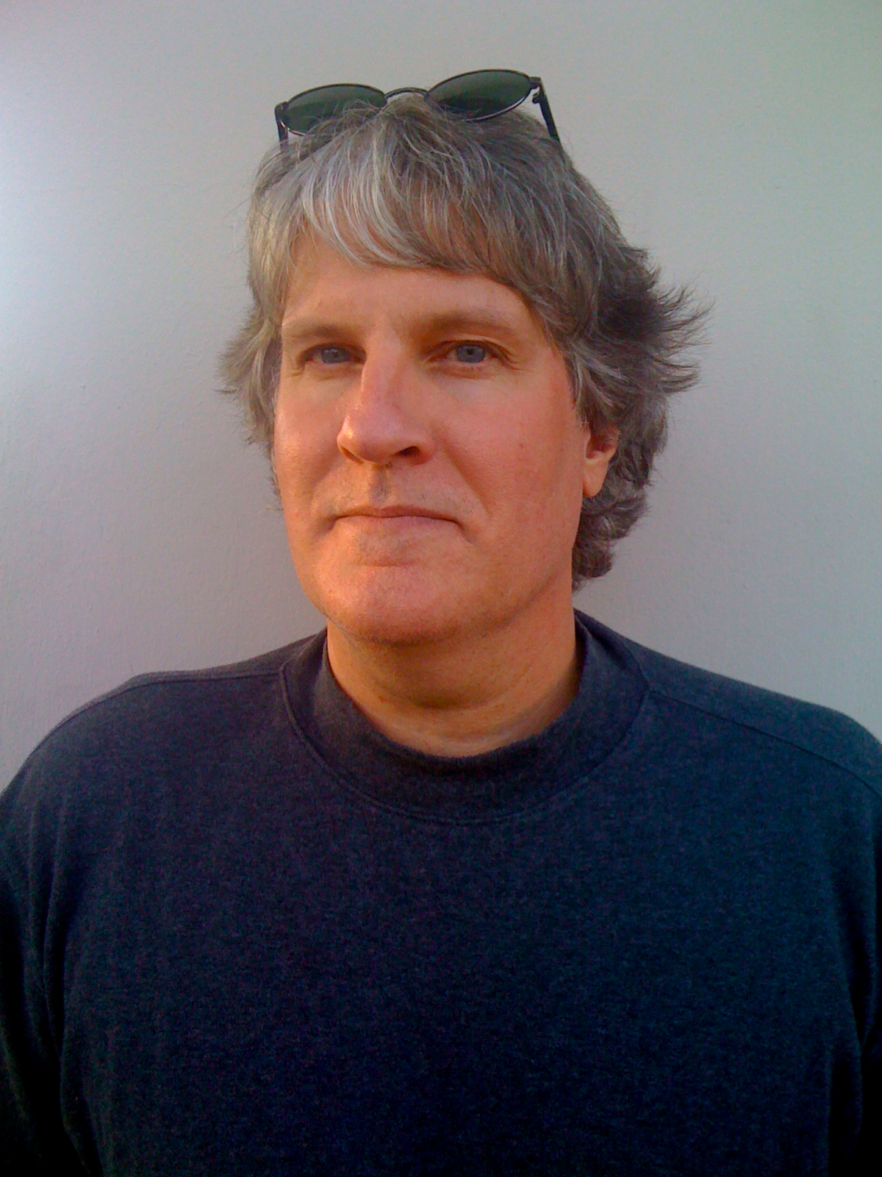
Chi-square: Falck and Gibbs 2012
Research question:
Do bodily experience of paths vs. roads motivate metaphorical meanings?
Data:
Experiment + British National Corpus
Factors:
path vs. road
vs.
description of courses of action/ways of living vs. purposeful activity/political/financial matters
Result: p<0.001; evidence that people’s understanding of their physical experiences with paths and roads also informs their metaphorical choices, making path more appropriate for descriptions of personal struggles, and road more appropriate for straightforward progress toward a goal

Slide 14
Falck & Gibbs 2012:
path/road vs. descriptions

Slide 15
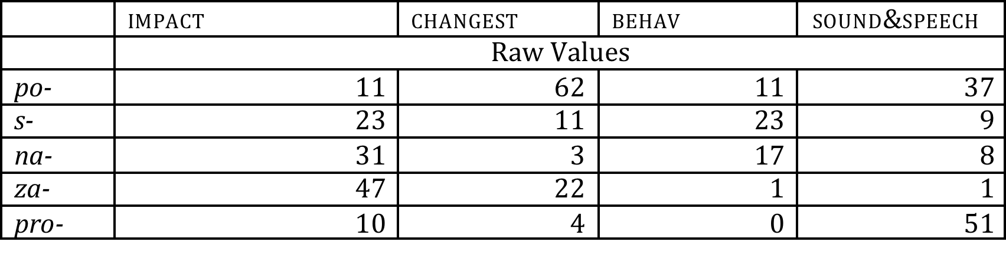
How can we use the Fisher Test to measure
the relationship of each number
to the rest of the matrix?
Let’s look at pro- with sound & speech

Slide 16
Fisher test: Finding out whether a value deviates significantly from the overall distribution
Illustration: There are 51 Natural Perfective verbs prefixed in pro- in the Russian National Corpus that have the semantic tag “sound & speech”. This exceeds the expected value, but is there a relationship between the prefix and the semantic class?
a = value in the given cell = 51 | b = row total - value in the given cell = 106 - 51 = 55
c = column total - value in the given cell = 65 - 51 = 14 | d = table total - value in the given cell - b - c = 382 - 51 - 55 - 14 = 262
NOTE: You need to know the relationship between the observed and the expected value before you can do the Fisher test. If the observed value is greater than the expected value, you need to choose alternative=”greater” to test the significance of finding a value this high or higher. If the observed value is less than the expected value, you need to choose alternative=”less” to test the significance of finding a value this low or lower. p-value < 2.2e-16

Slide 17
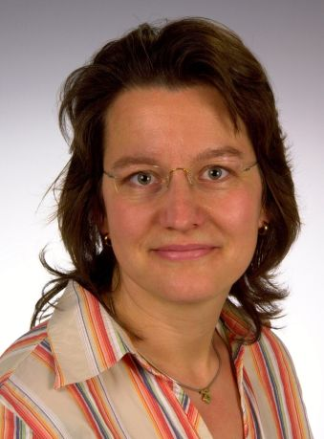
Fisher test: Hampe 2011
Research question:
Is the “denominative construction” with NP-complement (Schoolmates called John a hero) distinct from the caused-motion construction with locative complement (I sent the check to the tax-collector) and the resultative construction with adjectival complement (Bob made the problem easy) in English?
Data: ICE-GB
Focus:
attraction of lexemes to each of the three constructions
Result: the list of attracted lexemes is very different for each construction

Slide 18
Hampe 2011: Comparison of collustructional attractions for the three constructions

Slide 19
Exact Binomial test: Finding out whether the distribution in a sample is significantly different from the distribution of a population
Illustration: If you know that there are ten white balls and ten red balls in an urn, you can calculate the chance of drawing three red balls when four total balls are drawn (and replaced each time) as p = 0.3125, or nearly a one in three chance
Use in linguistics:
When you know the overall frequency of two alternatives in a corpus and want to know whether your sample differs significantly from what one would expect given the overall distributions in the corpus.
For example, one could use the exact binomial test to compare the frequency of a given lexeme in a certain context with its overall frequency in the corpus to see whether there is an association between the context and the word

Slide 20

Exact Binomial test: Gries 2011
Research question:
Does alliteration (bite the bullet) contribute to cohesiveness of idioms in English?
Data: ICE-GB
Focus:
211 high-frequency fully lexically specified idioms, 35 with alliterations; baseline measures of alliteration
partially lexically specified way-construction (wend one’s way)
Result: all p < 0.001; hypothesis supported

Slide 21
Gries 2011:
Observed and expected percentages of alliterations

Slide 22
T-test and ANOVA: Finding out whether group means are significantly different from each other
T-test illustration:
We do an experiment collecting word-recognition reaction times from two groups of subjects, one that is exposed to a priming treatment that should speed up their reactions (the test group), and one that is not (the control group).
The mean scores of the two groups are different, but the distributions overlap since some of the subjects in the test group have reaction times that are slower than some of the subjects in the control group.
Do the scores of the test group and the control group represent two different distributions, or are they really samples from a single distribution (in which case the difference in means is merely due to chance)?
The t-test can answer this question by giving us a p-value.

Slide 23
More about variance and ANOVA
F = between-groups variance
within-groups variance
ANOVA stands for “analysis of variance”
Variance is a measure of the shape of a distribution in terms of deviations from the mean
ANOVA divides the total variation among scores into two groups, the within-groups variation, where the variance is due to chance vs. the between-groups variation, where the variance is due to both chance and the treatment effect (if there is any).
The F ratio has the between-groups variance in the numerator and the within-groups variance in the denominator.
If F is 1 or less, the inherent variance is greater than or equal to the between-groups variance, meaning that there is no treatment effect.
If F is greater than 1, higher values show a greater treatment effect and ANOVA can yield p-values to indicate significance.
ANOVA can also handle multiple variables, for example priming vs. none and male vs. female and show whether each variable has an effect (called a main effect) and whether there is an interaction between the variables (for example if females respond even better to priming).

Slide 24

ANOVA: Dąbrowska et al. 2009
Research question:
Do speakers perform as well on unprototypical examples of LDDs as on prototypical ones?
(LDD = long-distance dependency)
Prototypical LDD: What do you think the funny old man really hopes?
Unprototypical LDD: What does the funny old man really hope you think?
Data: Experiment
Factors:
construction (declarative vs. question)
prototypical vs. unprototypical
age
Result: Both construction (p = 0.016) and prototypicality (p = 0.021) were found to be main effects, but not age. Significant interaction between construction and age (p = 0.01). Support for usage-based approach, according to which children acquire lexically specific templates and make more abstract generalizations about constructions only later, and in some cases may continue to rely on templates even as adults.

Slide 25
Dąbrowska et al. 2009
Main effect of construction (F = 6.47, p = 0.016)
Main effect of prototypicality (F = 5.82, p = 0.021)
Interaction construction/age (F = 7.51, p = 0.010)

Slide 26
Correlation: Finding significant relationships among values
Illustration for correlation: If you have data on the corpus frequencies and the reaction times in a word-recognition experiment for a list of words, you can find out whether there is a relationship between the two sets of values. Correlation, r = +1 for a perfect positive correlation, r = 0 for no correlation, r = -1 for a perfect negative correlation.
CAVEATS: 1) assumption of linear relationship; 2) correlation does not imply causation

Slide 27
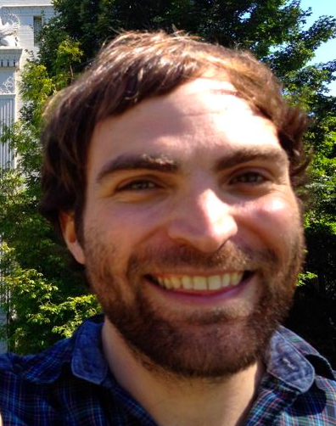
Correlation: Ambridge & Goldberg 2008
Research Question:
Are backgrounded constructions islands; are they hard to extract in LDDs?
Data: Experiment
“difference score” measures to what extent a clause is an island = difference in acceptability between extraction in questions (Who did Pat stammer that she liked) and declarative (Pat stammered that she liked Dominic)
“negation test” measures to what extent clause is assumed background = rating that She didn’t think that he left implies He didn’t leave.
Factors: difference score vs. negation test
Result: Mean negation test score was a highly significant negative predictor of mean difference score; r = -.83, p = 0.001

Slide 28
Ambridge & Goldberg 2008

Slide 29
Regression: Finding significant relationships among values
Regression builds upon correlation (the regression line is a correlation line), so it inherits all the caveats of correlation.
Regression is useful when you have found (or suspect) a relationship between a dependent variable and an independent variable, but there are other variables that you need to take into account
Dependent variable = the one you are trying to predict
Independent variables = the ones that you are using to predict the dependent one

Slide 30

Regression: Diessel 2008
Research question:
Does the linear order of clauses reflect the order of the reported events such that adverbial clauses reporting prior events are more likely to precede the main clause, whereas adverbial clauses reporting posterior events are more likely to follow the main clause? Is a speaker is more likely to produce After I fed the cat, I washed the dishes than I washed the dishes after I fed the cat ?
Data: ICE-GB
Factors:
dependent variable: position of adverbial clause (initial vs. final)
independent variables: conceptual order (iconicity), meaning (conditional, causal), length, and syntactic complexity
Result: All variables except syntactic complexity are significant. Meaning is significant only for the positioning of conditional once- and until-clauses, and length is significant only for once- and until-clauses.

Slide 31
Diessel 2008
Chi-squared = 14.25, df =1, p < 0.001,
but more factors need to be considered

Slide 32
Diessel 2008

Slide 33
Diessel 2008

Slide 34
Diessel 2008
Look at regression coefficient (first column):
Positive values indicate that the predictor variable increases the likelihood of the adverbial clause to precede the main clause.
Negative values indicate that the predictor variable decreases the likelihood of the adverbial clause to precede the main clause.

Slide 35
Mixed effects: Adding individual preferences into a regression model
Mixed effects builds upon regression: In an ordinary regression model, all effects are fixed effects. A mixed effects model combines fixed effects with random effects.
Fixed effect: an independent variable with a fixed set of possible values
Random effect: represent preferences of individuals sampled randomly from a potentially infinite population
Mixed effects models combine fixed effects and random effects in a single regression model by measuring the random effects and making adjustments so that the fixed effects can be detected.

Slide 36
When do we need mixed effects models?
Mixed effects models are used when individual preferences interfere with obtaining independent observations. Individuals with preferences need to be represented as random variables.
Some examples of random variables:
Subjects in an experiment will have different individual preferences, and different measures for baseline performance (e.g., reaction time)
Authors in a corpus will have different individual preferences for certain words, collocations, and grammatical constructions
Verbs in a language can have different individual behaviors with respect to ongoing changes and distribution of inflected forms

Slide 37

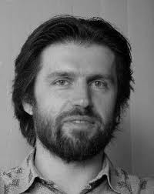

Mixed Effects: Zenner, Speelman, & Geeraerts 2012
Research question:
In Dutch, English loanwords like backpacker co-exist with native equivalents like rugzakker. What factors contribute to the success/failure of loanwords?
Data: Dutch newspaper corpora
Factors:
dependent variable: success rate of English loanword
independent variables as fixed effects: length, lexical field, era of borrowing, luxury vs. necessary borrowing, concept frequency, data of measurement, register, region
independent variable as random effect: concept expressed
Result:
Two strongest main effects: a negative correlation between concept frequency and the success of an anglicism, and a significantly lower success rate for borrowings from the most recent era (after 1989) than from earlier eras. Interactions: concept frequency is a factor only when the anglicism is also the shortest lexicalization, and the difference between luxury and necessary borrowings is strongest in the 1945-1989 era.

Slide 38
Zenner, Speelman, & Geeraerts 2012

Slide 39
Zenner, Speelman, & Geeraerts 2012

Slide 40
Cluster analysis: Finding out which items are grouped together
Cluster analysis is useful when you want to measure the distances between items in a set, given that you have an array of datapoints connected to each item.
In hierarchical cluster analysis, squared Euclidean distances are used to calculate the distances between the arrays of data.
Other methods to achieve similar means include multidimensional scaling and correspondence analysis.

Slide 41

Cluster analysis: Janda & Solovyev 2009
Research question:
Can we measure the distance among near-synonyms?
Data: Russian National Corpus and Biblioteka Moškova
Factors:
Near-synonyms for ‘happiness’ and ‘sadness’
(Preposition)+ case constructions
Result: Each noun has a unique constructional profile, and there are stark differences in the constructional profiles of words that are unrelated to each other. For the two sets of synonyms in this study, only six grammatical constructions are regularly attested. The study shows us which nouns behave very similarly as opposed to which are outliers in the sets. The clusters largely confirm the introspective analyses found in synonym dictionaries, giving them a concrete quantitative dimension, but also pinpointing how and why some synonyms are closer than others.

Slide 42
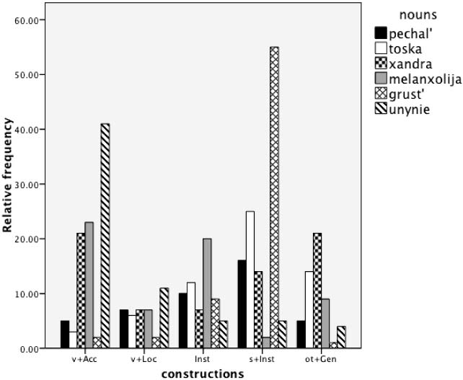
Chi-square = 730.35, df = 30, p < 0.0001, Cramer’s V = 0.305

Slide 43

‘Sadness’
Hierarchical Cluster
pečal’
toska
xandra
melanxolija
grust’
unynie

Slide 44

Grammatical Profiles: TAM in Russian
Janda, L. A. & Lyashevskaya, O. 2011. “Grammatical profiles and the interaction of the lexicon with aspect, tense and mood in Russian”. Cognitive Linguistics 22:4 (2011), 719-763.

Slide 45
Crash course in Russian TAM
Tense: Past vs. Non-Past
Non-Past: Imperfective = Present vs. Perfective = Future
Aspect: Perfective (marked) vs. Imperfective (unmarked)
All forms of all verbs express aspect
“Aspectual pairs” = same lexical meaning, different aspect, e.g., pisat’ ‘write[imperfective]’ vs. napisat’ ‘write[perfective]’
Aspectual pairs can be formed via both prefixation and suffixation (perepisat’ ‘rewrite[perfective]’ vs. perepisyvat’ ‘rewrite[imperfective]’)
≈1400 imperfective base stems form ≈2000 perfective aspectual partners using 16 prefixes
≈20K perfective stems form imperfective partners using 3 suffixes
These affixes are traditionally assumed to be “empty”
Mood: imperative, infinitives in modal constructions

Slide 46
Grammatical Profiles: TAM in Russian
Theoretical focus:
Can we measure the expression of aspect according to distribution of inflected forms?
Can we distinguish between prefixation vs. suffixation in formation of aspectual pairs?
Can we measure the attraction of lexical classes to grammatical categories?

Slide 47
Grammatical Profiles: TAM in Russian
Operationalization:
Grammatical profiles: frequency distribution of inflected forms
➜Distribution of Russian verb forms according to subparadigm
➜Distribution of Russian verbs according to subparadigm
Data:
Approx. 6M verb forms from the Russian National Corpus (http://ruscorpora.ru/ )
Statistics:
Chi-square, Cramer’s V effect size, distribution plots

Slide 48

What is a grammatical profile?
Verbs have different forms:
eat 749 M
eats 121 M
eating 514 M
eaten 88.8 M
ate 258 M
The grammatical
profile of eat
Notes:
Figures from google – this is NOT a scientific way to do grammatical profiles, but it gives us a rough approximation to illustrate

Slide 50
Grammatical Profiles of Russian Verbs
 | Nonpast | Past | Infinitive | Imperative
Imperfective | 1,330,016 | 915,374 | 482,860 | 75,717
Perfective | 375,170 | 1,972,287 | 688,317 | 111,509
chi-squared
= 947756
df = 3
p-value < 2.2e-16
effect size
(Cramer’s V)
= 0.399
(medium-large)
Notes:
Based on verbs with 100 or more attestations in RNC

Slide 51
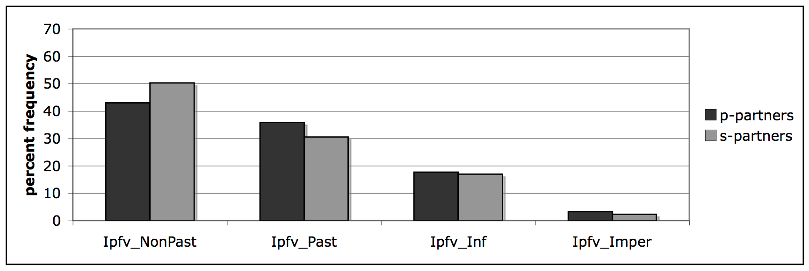
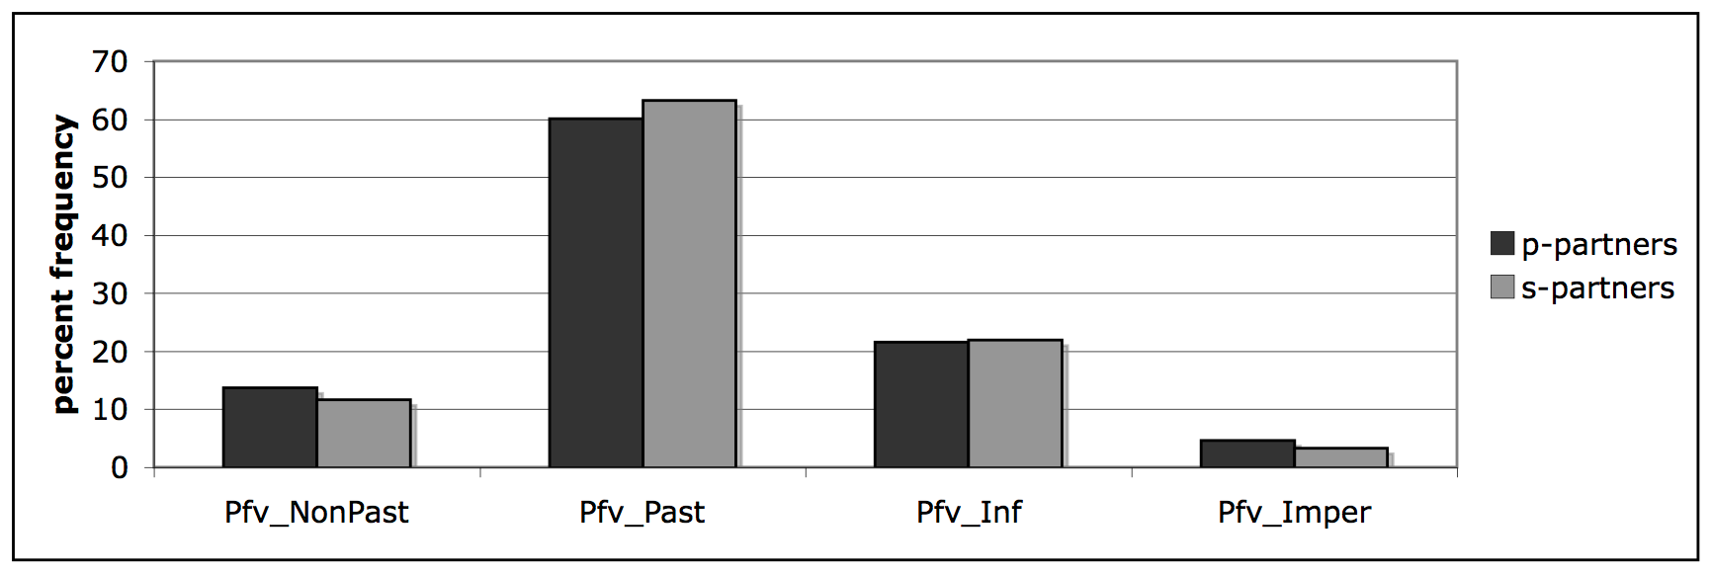
Distribution of Russian verb forms according to subparadigm
Prefixation (dark) vs. suffixation (light):
Statistically significant, BUT effect sizes too small (0.076 & 0.037)

Slide 52
Distribution of Russian verbs according to subparadigm:
Imperfective verbs and their attraction to imperative
Over 200 outliers

Slide 53
Imperfective imperative “be doing X!”
Polite: guest knows what to expect: razdevajtes’ ‘take off your coat’, sadites’ ‘sit down’
Insistence: hearer is hesitant: stupajte ‘get going’, gljadite ‘look’, zabirajte ‘take’
Insistence: hearer has not behaved properly (connection with negation): provalivaj ‘get out of here’, končaj ‘stop’, ne perebivaj ‘don’t interrupt’
Polite requests: vyručajte ‘help’
Kind wishes: vyzdoravlivajte ‘get well’
Idiomatic: davajte posmotrim ‘let’s take a look’
Idiomatic/culturally anchored: proščaj(te) ‘farewell’, soedinjajtes’ ‘unite’ (slogan), zapevaj ‘sing’ (army)

Slide 54
Grammatical Profiles: Findings
Perfective verbs behave differently than imperfective verbs
“Verb pairs” behave the same regardless of which type of morphology (prefixation vs. suffixation) is used to mark aspect
We can identify exactly the verbs that are most attracted to various TAM combinations.

Slide 55
Semantic Profiles: “Empty” prefixes in Russian
Janda, L. A. & Lyashevskaya, O. 2013. “Semantic Profiles of Five Russian Prefixes: po-, s-, za-, na-, pro-”. Journal of Slavic Linguistics 21:2, 211-258.

Slide 56
Semantic Profiles: “Empty” prefixes in Russian
Big Questions:
What is the relationship between form and meaning?
➜ ...between prefixes and meanings of verbs?
Are there any “empty” forms?
➜ Are prefixes empty as claimed?
Imperfective base | Prefixed perfective
sovetovat’ ‘advise’ | posovetovat’ ‘advise’
varit’ ‘cook’ | svarit’ ‘cook’
pisat’ ‘write’ | napisat’ ‘write’
tverdet’ ‘harden’ | zatverdet’ ‘harden’
gremet’ ‘thunder’ | progremet’ ‘thunder’

Slide 57
Semantic Profiles: “Empty” prefixes in Russian
Theoretical focus:
Can we measure the relationship between prefixes and meanings of verbs?
➜ Distribution of prefixes vs. semantic groups of verbs
How do we show that “empty” forms aren’t really empty?
➜ Show that prefixes have different semantic behaviors

Slide 58
Semantic Profiles: “Empty” prefixes in Russian
Operationalization:
Semantic profiling: relationship between meanings (semantic tags) and forms
➜Distribution of Russian verb prefixes vs. semantic tags
Data:
382 verbs with “empty” prefixes from the Exploring Emptiness database (http://emptyprefixes.uit.no/index.php ), semantic tags independently assigned in the Russian National Corpus (http://ruscorpora.ru/ )
Statistics:
Chi-square, Cramer’s V effect size, Fisher Test

Slide 59
chi-square = 248, df = 12, p = 2.2e-16; Cramer’s V effect-size = 0.4

Slide 60
Semantic Profiles: Findings
Each prefix has a unique semantic profile
Each prefix is attracted to and repulsed by a different set of semantic classes of verbs
It is possible to establish meanings of prefixes and expectations for how prefixes combine with verbs

Slide 61

Semantic Profiles: Multipurpose Applications
Pedagogical implications:
We can design materials that reduce the burden of memorizing ≈2000 correct prefix-verb combinations

Slide 62


Radial Category Profiles: Ambipositions in North Saami
Antonsen, L., Janda, L. A., & Baal, B. A. B. “Njealji davvisámi adposišuvnna geavahus” [“The Use of Four North Saami Adpositions”], co-authored with Lene Antonsen[1] and Berit Anne Bals Baal[3], Sámi dieđalaš áigečála 2012, v. 2. 32pp.
Janda, L. A., Antonsen, L. & Baal, B. A. B. Forthcoming. “A Radial Category Profiling Analysis of North Sámi Ambipositions”. High Desert Linguistics Society Proceedings, Volume 1. 11 pp.

Slide 63

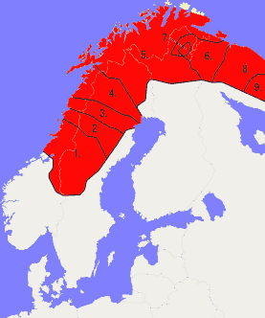
Crash course in North Saami ambipositions
Unusually large number of adpositions that can appear as both prepositions and postpositions, always use Genitive case
1. a. miehtá dálvvi b. dálvvi miehtá
[over winter-G] [winter-G over]
‘during the winter’
2. a. čađa áiggi b. áiggi čađa
[through time-G] [time-G through]
‘through time’
3. a. rastá joga b. joga rastá
[across river-G] [river-G across]
‘across the river’
4. a. maŋŋel soađi b. soađi maŋŋel
[after war-G] [war-G after]
‘after the war’
5 = North Saami

Slide 64
Radial Category Profiles: North Saami ambipositions
Big Questions:
What is the relationship between form and meaning?
➜What is the relationship between position (preposition vs. postposition) and meaning?
What is the influence of majority languages (prepositional languages in West vs. postpositional languages in East)?
Is there a relationship between frequency of ambipositions and their use to distinguish meaning?

Slide 65
Radial Category Profiles: North Saami ambipositions
Theoretical focus:
Can we measure the difference between uses in preposition vs. postposition?
Can we model the meanings in terms of a radial category?
Can we measure dialectal differences?

Slide 66
Radial Category Profiles: North Saami ambipositions
Operationalization:
Radial category profiling: differences in the frequency distribution of uses across two or more near-synonyms
➜Distribution across uses in radial category for preposition vs. postposition
Data: 100+ sentences for each position from 10M word newspaper corpus, plus exx. from literature, Bible translation
Statistics:
Chi-square, Cramer’s V effect size

Slide 67
Radial categories: miehtá ‘over’ in newspapers
time
9%
extent
79%
time
95%
extent
5%
motion
12%
preposition
postposition
chi-squ = 170, df = 2, p < 2.2e-16; Cramer’s V = 0.85
Notes:
Statistically significant difference, large effect size -- test on time vs. space (collapses motion and extent)

Slide 68
Distribution of adpostitions
Х²=129.7, df=2, p<2.2e-16
Cramer’s V=0.48

Slide 69
Radial Category Profiles: Findings
There is a relationship between meaning and position
Prevailing trends in majority languages do influence use of position
There seems to be a typological relationship between frequency of ambipositions and their use to distinguish meaning
Languages with few ambipositions (Germanic, Russian) do not use position distinctively
Languages with more ambipositions use them in more complex ways (North Saami > Finnish, Estonian)

Slide 70
Radial Category Profiles: Multipurpose Applications
Pedagogical implications:
Teach ambipositions with relevant meanings and nouns
Improvements to constraint grammar analyzer:
Improves linguistic analysis and language technology tools, these are crucial to preserving and revitalizing the language

Slide 71

TROLLing
is an international archive of linguistic data and statistical code
is built on the Dataverse platform from Harvard University and complies with DataCite, the international standard for storing and citing research data
is compliant with CLARIN, the EU research infrastructure for language-based resources
assigns a permanent URL to each post
uses metadata that ensures visability and retrieval through international services
is professionally managed by the University Library of Tromsø and an international steering committee

